Slide 1
Java Architecture

Slide 2
Introduction
Java Architecture is a collection of components, i.e., JVM, JRE, and JDK.
It integrates the process of interpretation and compilation.
It defines all the processes involved in creating a Java program.
Java Architecture explains each and every step of how a program is compiled and executed.

Slide 3
Java Virtual Machine
The main feature of Java is WORA. WORA stands for Write Once Run Anywhere.
The feature states that we can write our code once and use it anywhere or on any operating system.
Our Java program can run any of the platforms only because of the Java Virtual Machine.
It is a Java platform component that gives us an environment to execute java programs.
JVM's main task is to convert byte code into machine code.

Slide 4
Java Runtime Environment
It provides an environment in which Java programs are executed.
JRE takes our Java code, integrates it with the required libraries, and then starts the JVM to execute it.

Slide 5
Java Development Kit
It is a software development environment used in the development of Java applications and applets.
Java Development Kit holds JRE, a compiler, an interpreter or loader, and several development tools in it.

Slide 6
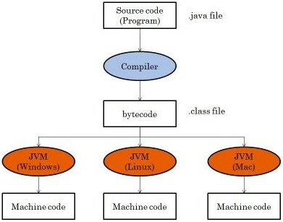

Slide 7
Bytecode
Java bytecode is the instruction set for the Java Virtual Machine.
It acts similar to an assembler which is an alias representation of a C++ code.
As soon as a java program is compiled, java bytecode is generated. In more apt terms, java bytecode is the machine code in the form of a .class file.
With the help of java bytecode we achieve platform independence in java.

